Slide 1

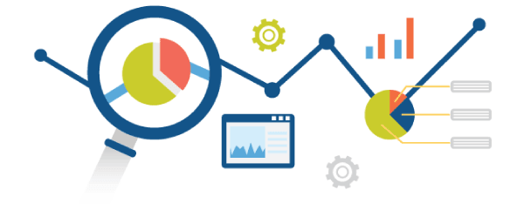

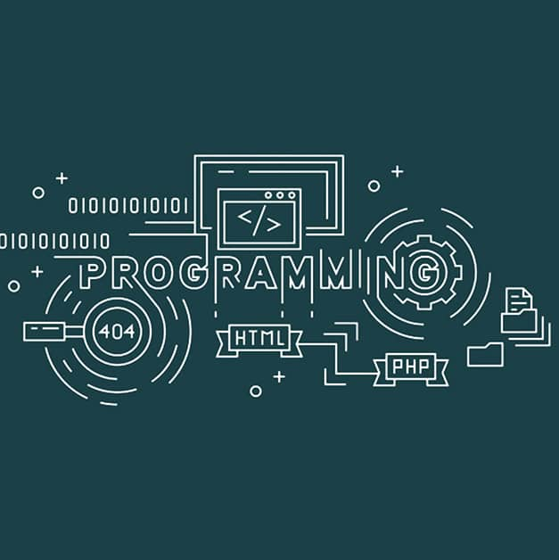
Predictive Analysis using Python🐍
Guido Van Rossum

Slide 2




PRAMOD VISHNU NAIK
Current Position: Software Development Engineer (Full-Stack, MERN stack and Gen AI Developer), MResult Technologies Pvt Ltd.
Educational Qualification: MCA (Specialization in Data Science and Cloud Computing), Srinivas University, Mangalore Certifications: AWS Certified Professional
Experience:
3.5 years of professional experience in software development
Assistant Professor (Guest Lecture and Mentor) with 2 years of teaching experience.
Skills:
Primary Skills: AWS, ML, Node.js, React, Redux Toolkit, TypeScript, Express.js, Python, FastAPI, Flask, SQL, PostgreSQL, MySQL, Java, PHP, DataIKU, Snowflake, Informatica IICS.
PRAMOD NAIK
Address: Mangalore, Karnataka.
+91 9611025113
pramodnaik.dev@gmail.com

Slide 3

Problem Statement:
What will we accomplish in this workshop?

Slide 4
Predictive Analysis:
Predictive Analysis (or Predictive Analytics) is the process of using historical data + statistical models + machine learning to predict future outcomes.
It doesn’t just tell you what happened in the past (descriptive) but also what is likely to happen in the future.
Example:
Predicting Next Year’s College Admissions
Retail Sales Forecasting
Weather Prediction
Student Exam Performance

Slide 5
Python libraries for Predictive Analysis
Library | Use Case
Pandas | Data manipulation & preprocessing
NumPy | Numerical computing foundation.
Matplotlib & Seaborn | Data visualization.
Scikit-learn (sklearn) | Machine learning & predictive modeling
SciPy | Scientific computing
TensorFlow & Keras | Deep learning frameworks

Slide 6


Slide 7
🐼 Pandas in Python for Data Analysis?
Pandas is a powerful and popular open-source Python library used for data manipulation, analysis, and cleaning. It provides easy-to-use data structures and functions to work with structured (tabular) data efficiently.
Pandas = Panel Data → used for handling structured data (tabular form).
Built on top of NumPy → optimized for fast operations.
Why Pandas?
It simplifies data analysis tasks.
Makes large data easy to understand and manipulate.
Built on top of NumPy, so it's very fast.

Slide 8


Slide 9
NumPy : TheNumPy NumPy (Numerical Python) is a powerful library in Python used for numerical computing. It provides support for large, multi-dimensional arrays and matrices, along with a collection of mathematical functions to operate on these arrays efficiently.
Why Use NumPy?
Faster than Python lists: NumPy arrays are more efficient than Python lists due to optimized memory and vectorized operations.
Supports Multi-dimensional Arrays: Easily handles 1D, 2D, and ND arrays.
Rich Mathematical Functions: Offers functions like mean, median, standard deviation, linear algebra, etc.
Integration with Libraries: Used in Pandas, Matplotlib, Scikit-Learn, TensorFlow, etc.

Slide 10
Role of Pandas and NumPy in Predictive Analytics
Predictive Analytics = Data Preparation + Modeling + Prediction + Evaluation
Pandas and NumPy sit in the data preparation & mathematical foundation stages.

Slide 11
1. Role of Pandas
Pandas provides the data manipulation & analysis layer:
Read & clean data (CSV, Excel, SQL, JSON).
Handle missing values, duplicates, outliers.
Perform feature engineering (create new predictive variables).
Handle time-series data (resampling, rolling averages).
Integrates smoothly with NumPy and ML libraries (Scikit-learn, TensorFlow).
👉 Pandas is like the data wrangler, NumPy is the math engine.

Slide 12
2. Role of NumPy
NumPy provides the mathematical foundation for predictive analytics:
Efficient handling of numerical arrays & matrices.
Performs vectorized computations (fast calculations).
Implements linear algebra (matrix multiplication, inversion, eigenvalues) — essential for regression, PCA, neural networks.
Random number generation for simulations & ML model initialization.
👉 Without NumPy, ML algorithms (like linear regression, logistic regression, neural nets) would be very slow in pure Python.

Slide 13
Machine Learning (ML)
ML is an application of AI that provides Systems or Models the ability to automatically learn and improve from experience without being explicitly programmed and without human intervention .
Machine Learning (ML) is a subfield of artificial intelligence (AI) that focuses on the development of algorithms and models that enable computers to learn and make predictions or decisions without being explicitly programmed for a specific task.
The primary aim of machine learning is to allow the computers learn automatically without human intervention or assistance and adjust actions accordingly.
Examples:
The Self-Driving Car
The Spam Filter
Music Recommender
Personal Assistance (Alexa)

Slide 14
Definition:
According to Tom Mitchell Machine Learning is the study of algorithms that improve their performance P at some task T with experience E. A well-defined learning task for a system is given by <P, T, E>.
AI, ML and DL:
AI: Creation of Intelligent Machines that think and act like a Humans Ex: Robots.
ML: Approach for Computers to learn without being explicitly programmed.
DL: Training of Machines to think like a human brains- Application of Artificial Neural Networks.

Slide 15
Traditional Programming V/S Machine Learning :
Traditional Programming:
In traditional programming, a computer engineer writes a series of directions that instruct a computer how to transform input data into a desired output. Instructions are mostly based on an IF-THEN structure: when certain conditions are met, the program executes a specific action.
Machine Learning:
Machine learning, on the other hand, is an automated process that enables machines to solve problems with little or no human input, and take actions based on past observations.

Slide 16

Hands-On

Slide 17

Follow the ReadMe.md File in GitHub…

